Slide 1
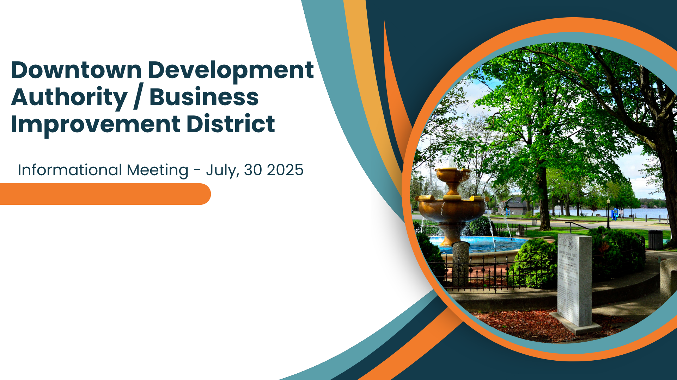
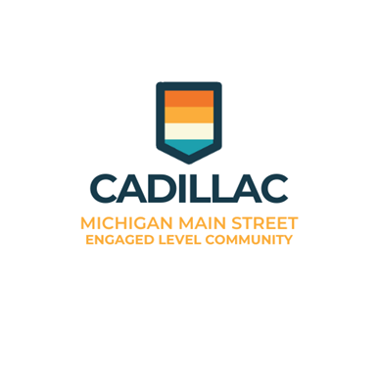
Notes:
Thank You for attending this Semiannual information meeting of the Downtown Development Authority –
During this presentation, I’ll
Review state laws and statutory obligations that authorize the DDA, Tax Increment Financing and the Development Plan
Identify DDA Board members
Review TIF and Development plan direction that guides the DDA
Explore how the Main Street Program provides structure, support and resources to meet DDA goals

Slide 2
PA 57 of 2018
Informational Meetings Sec. 910 (4)
The State requires Downtown Development Authorities to hold two informational meetings annually. Informational meetings are meetings held for the purpose of informing the public of the goals and direction of the authority, including projects to be undertaken in the coming year.
They are not for the purpose of voting on policy, budgets or other operational matters. The informational meetings may be held in conjunction with other public meetings of the authority or municipality.
Notes:
The Downtown Development Authority (DDA), Public Act
57 of 2018, is designed to be a catalyst in the development of
a community’s downtown district. The DDA provides for a
variety of funding options including a tax increment financing
mechanism, which can be used to fund public improvements in
the downtown district and the ability to levy a limited millage
to address administrative expenses.

Slide 3

Tax Increment Financing (TIF) & Development Plan
The goals and direction of the Cadillac DDA are defined by the TIF and Development Plan first created in 1992 and most recently amended in 2007.
The full document is available on our website, as required by law. Find it here: https://www.cadillac-mi.net/479/Downtown-Development-Authority-DDA
Notes:
In order to prevent further deterioration and to encourage historic preservation of the
downtown district, while also encouraging economic growth in the area, the Cadillac City
Council established the Downtown Development Authority of the City of Cadillac (the
“DDA”) pursuant to Act 197 of 1975 (“Act 197”) by adopting Ordinance 842 on June 14,
1976.
development plan describes the costs, location and resources
for the implementation of the public improvements that are
projected to take place in the DDA district. A tax increment
financing plan includes the development plan and details the
tax increment procedure, the amount of bonded indebtedness
to be incurred, and the duration of the program.
The purpose of this Tax Increment
Financing and Development Plan is to provide for the acquisition, construction, and
financing of necessary public improvements including parking, streetscapes, sidewalks, and
other facilities in the development area; to carry out the objectives of the DDA so as to
prevent further deterioration of the development area while preserving its historical character
and promoting economic growth to the benefit of all taxing units located within and benefited
by the development area

Slide 4
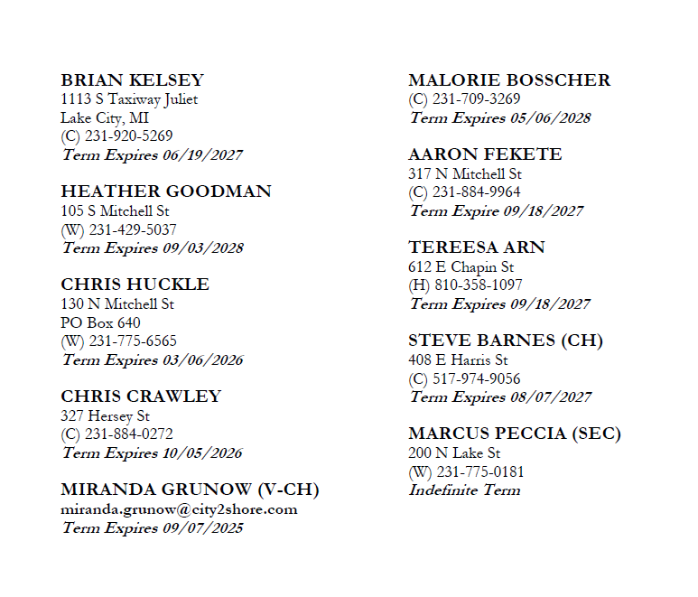
Dda board members

Slide 5

Goals and direction Last updated in tif plan in 2007
Parking Lot repairs and improvements
Burying of overhead powerlines
Sign Improvements
Streetscape beautification
Curb and gutter improvements
Storm water and wastewater sewer improvements
Acquisition and demolition of derelict buildings
Acquisition & renovation of several downtown commercial buildings
Promotion & marketing of downtown development area to facilitate business recruitment and retention
Notes:
As we move into the Main Street portion of the presentation, the overlap between the DDA and Main Street will become clear.

Slide 6


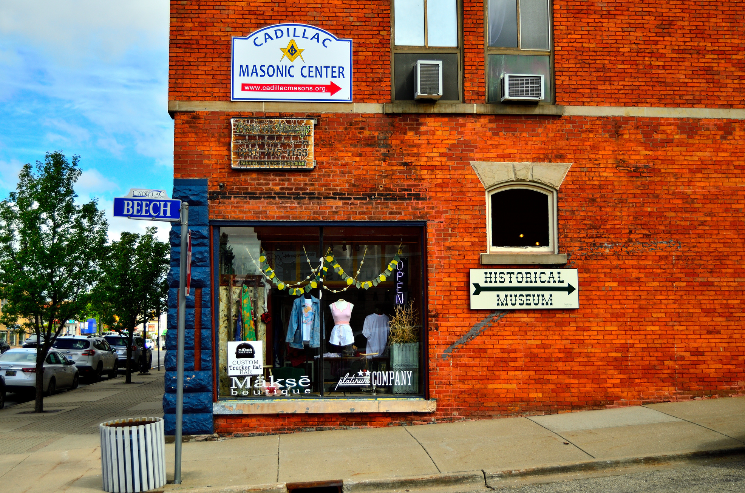
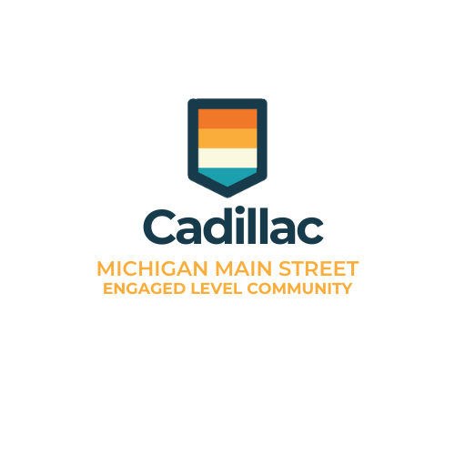


Main Street
Notes:
Cadillac joined the Main Street program in 2023. Existing goals align well, but MainStreet provides a lot of fire power via organizing steps, technical assistance, funding, an extensive network of downtowns that are already achieving these goals… It is a proven and tested framework for revitalization and economic development
MI Main Street assists with
Protecting and strengthening the existing tax base
Creating a positive community image
Creating visually appealing and economically viable downtown buildings
Attracting new businesses
Creating new jobs
Increasing investment in the downtown
Preserving historic architectural resources
Tailoring to specific community needs

Slide 7

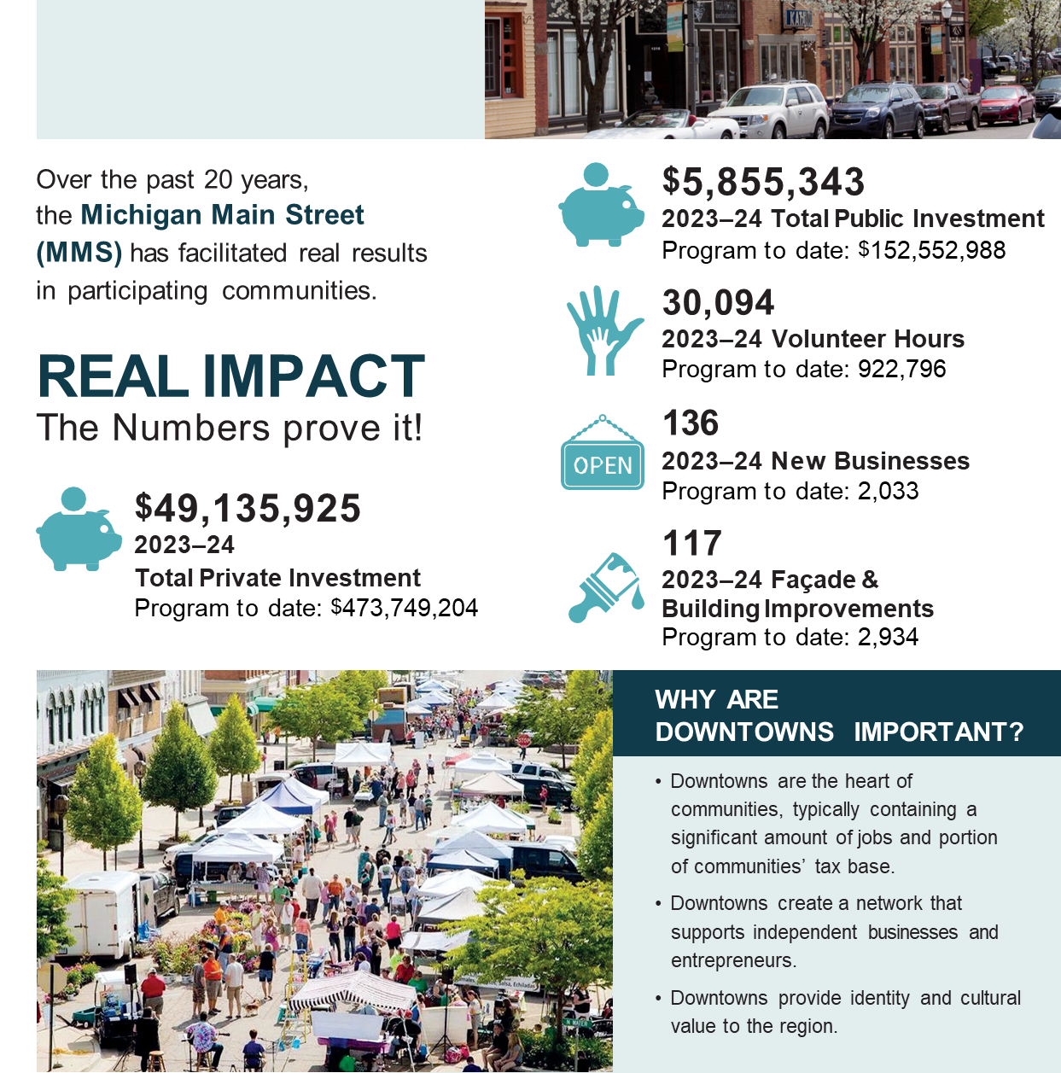
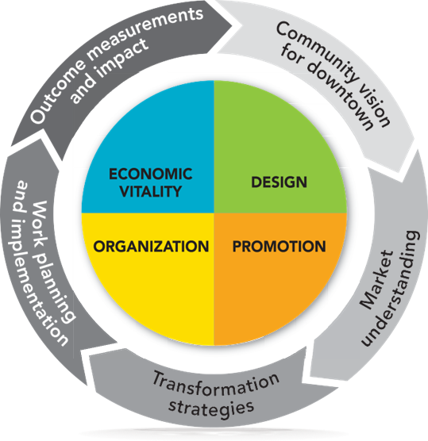
Notes:
This is what the Main Street Structure looks like – 4 points, and process

Slide 8




Vision & Mission
Downtown Cadillac Mission
Downtown Cadillac Vision
“To foster a vibrant, prosperous downtown district by enhancing the area’s economic base, improving aesthetics and accessibility, encouraging community engagement, and preserving the historical and cultural identity of Downtown Cadillac. We aim to create a thriving, inclusive, and dynamic Downtown that continues to be the heart of the Community.”
“We envision a vibrant, walkable downtown where thriving local businesses, cherished historic character, and dynamic public spaces come together to create an engaging destination for all. By supporting entrepreneurship, honoring our architectural heritage, and fostering a culture of creativity and community through strategic events, marketing, and placemaking, we aim to build a downtown that is economically resilient, culturally rich, and welcoming to residents and visitors alike.”
Notes:
Under the Main Street Program, our Downtown Cadillac Mission is, Vision is

Slide 9
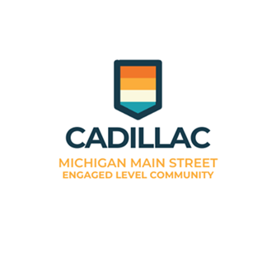
Notes:
Taking steps now under the MI Main Street Four Points, created working committees, divvied up the workload

Slide 10

Our Goals
Historic Preservation
Provide education and resources to property owners.
Encourage appropriate building & façade rehabilitation.
Build relationships with preservation partners.
Promote the benefits of historic preservation.
Conduct projects & programs that showcase the history.
Marketing
Develop a cohesive brand for downtown.
Develop a marketing strategy to promote downtown.
Generate materials, communication and social media posts.
Events
Host strategic events downtown.
Procure and manage sponsorships effectively.
Create an annual calendar with a mix of events.
Administrative
Have a dedicated person in place to represent downtown.
Define roles and responsibilities for the board, volunteers and staff.
Diversify funding for the organization.
Business Recruitment and Retention
Develop small business support resources.
Develop incentives to encourage reinvestment downtown.
Cultivate a vibrant business mix downtown.
Streetscapes
Create a walkable downtown district.
Facilitate physical improvements to the public realm.
Create a plan for managing traffic.
Develop a cleanup and maintenance program.
Arts and Beautification
Identify opportunities for public art.
Engage in placemaking activities.
Add green spaces and nature.
Main Street Four Point Approach
DESIGN
ECONOMIC VITALITY
ORGANIZATION
PROMOTION
Action-Oriented Work Plans
Notes:
Update the downtown area sidewalks, trees, parking and seating.
Improve basic infrastructure
Trash cans, lighting

Slide 11

Projects completed
Drafted position description, advertised and hired a DDA Director & Main Street Program Manager
Completed MI Main Street Engaged Level Work Plan Steps
Create Subcommittee(s) to Lead Main Street Efforts
Determine Main Street Area Boundaries
Complete Building and Business Inventory
Create Map of Main Street Area Boundary
Engage stakeholders through social media, establishment of a newsletter, and local media outlets
Facilitated meetings with developers to bring housing and businesses downtown
Downtown design guidelines drafted
Flowers
Notes:
Girl Scouts, City Pocket Park, DDA Hanging Baskets and contract with Hope Network - Hope Network helps people maximize their health, independence, and self-belief—because everyone deserves to live in a world where they can thrive.

Slide 12
Project updates
Awarded $750,000 state grant for improvements to the market. Improvements to the Market are nearly complete. Overhead doors have been installed. The restrooms remain under construction.
Awarded $200,000 Michigan Shared Streets and Spaces Grant for wayfinding signage, tables & chairs at the Market and pavilion at White Pine Trailhead & Haynes St Micro Park.
Applied for $50,000 T-Mobile Hometown Grant for public art. Grant was not awarded.

Slide 13



In progress
Safety audit was conducted by MDOT for Mitchell Street through downtown. Working on Streetscape design and researching grant funding.
Public boat dock inspected and design underway. Expecting an update at the end of this month. Applying for grant in early 2026.
Phase 2 of Cadillac Lofts construction began in spring of 2025.
Lake Street Apartment project (48 units) approved. Construction set to begin in Fall 2025.
Notes:
Streetscape committee meetings, Walkability Action Institute
Dock inspection initial results indicate no significant structural damage

Slide 14

Future Projects
Improve safety on Mitchell Street
Establish Downtown Cadillac website
Pursue public art projects - Murals
Beautification projects
Establish annual events calendar and plan community, special and retail events
Update Goals in Tax Increment Financing and Development Plan
Walkway behind the Pavilion
Update or new construction to Downtown Dock(s)

Slide 15
Staff training and updates
Michigan Main Street workshop September 29, 2025. One of two workshops held annually. Available for Engaged Level Communities.
Current Staff positions:
DDA Director / Main Street Manager Travis Owens
Community Development Director Theresa Waldo
Community Development Coordinator Danielle Timmer
Community Development Specialist Abigail Pluger

Slide 16
THANK YOU

