Slide 1
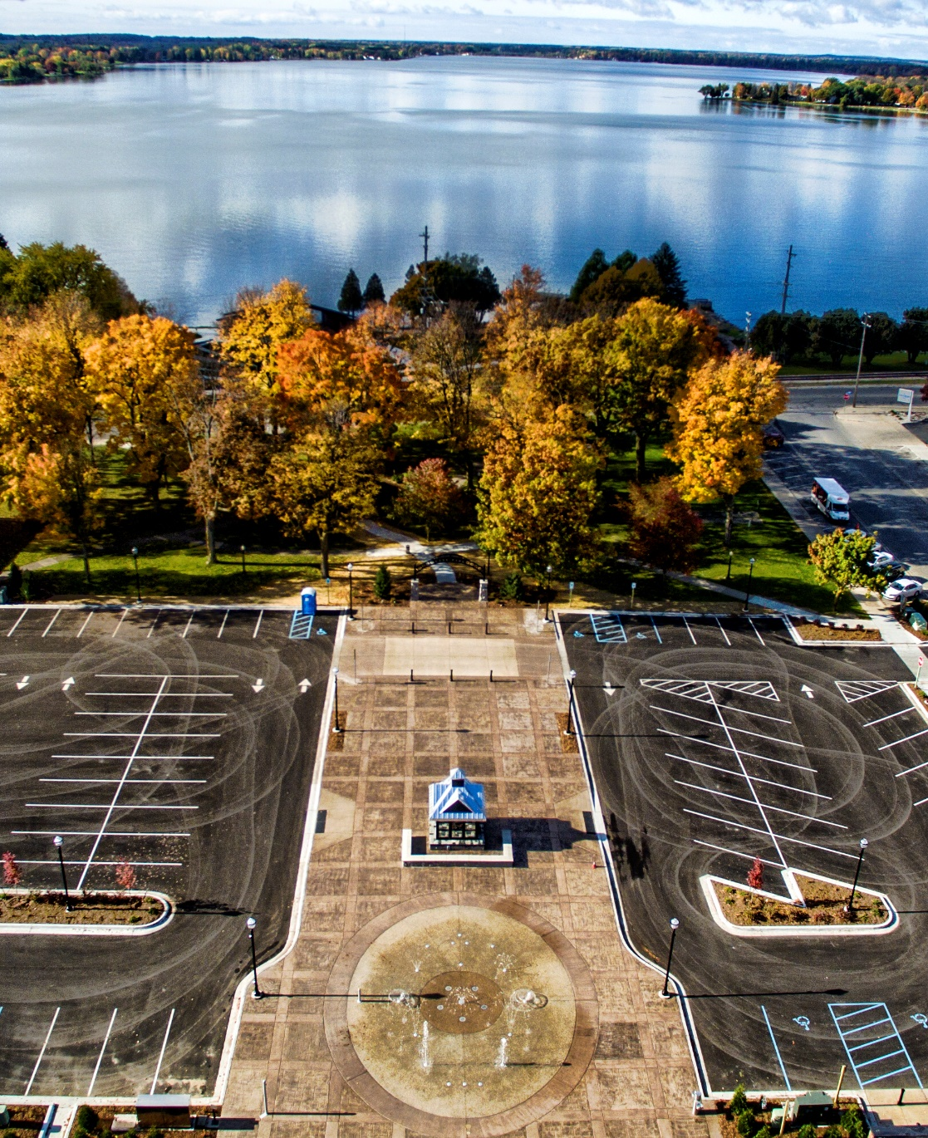
Short-term rental public forum
John Wallace
Community Development Director
City of Cadillac

Slide 2
AGENDA
Welcome
Recap Original Draft STR Ordinance
Recap Public Feedback since June 13
Updates Based on Feedback Received
Break
Q&A
Next Steps

Slide 3
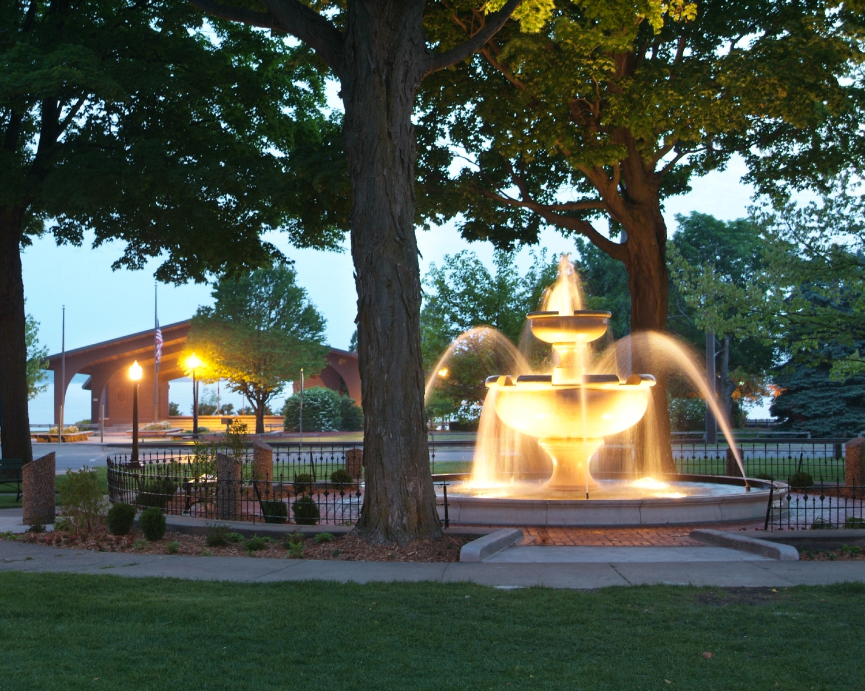
WELCOME

Slide 4
Recap of Original short-term rental ordinance
The City held a public forum on the new zoning ordinance and short-term rental regulations on June 13, 2023.
At the June 13th meeting the city presented a first draft of a map showing where short-term rentals would be permitted and also the regulations which would apply to doing short-term rentals.
  To get public feedback the city passed out comments cards and conducted a push pin exercise to gain perspective on where people wanted to see short-term rentals locate or not to be located.
  The city also provided time for anyone wishing to speak on the subject (either positive or negative) to give their comments.
  Based on the public feedback from the June 13 meeting, correspondence received, and an online public survey which was conducted between July 18 and August 14 the city has created a new draft of the regulations relating to short-term rentals and their permitted locations.

Slide 5
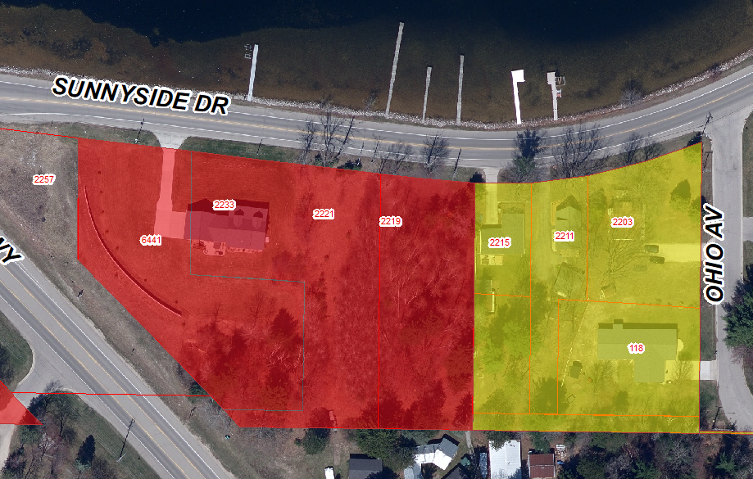
Sunnyside Block Zoning
IN RESPONSE TO COMMENTS AT THE PREVIOUS PUBLIC FORUM, THIS IS THE CURRENT ZONING
TS-2
R-1

Slide 6
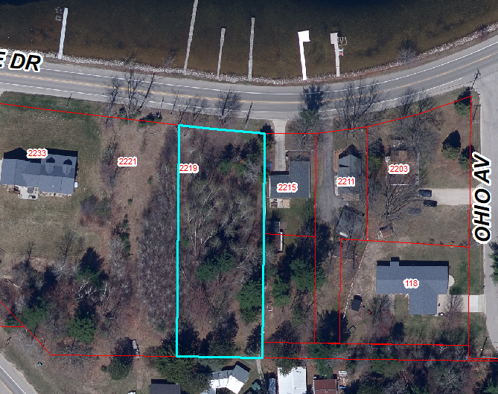
Campground “Easement” to Lake Cadillac: Response to comments at previous Public Forum
The Campground owns lot 2219 Sunnyside Drive. This is not an easement; it is owned land that allows for use of Lake Cadillac.

Slide 7

Public feedback since June 13 meeting
Oral Comments
Written Comments
Push Pins Exercise
Survey Results

Slide 8
Oral Comments
June 13 Meeting
15 people commented
10 people commented enforcement is key issue
10 comments were against STR’s
4 comments were in favor
of STR’s

Slide 9
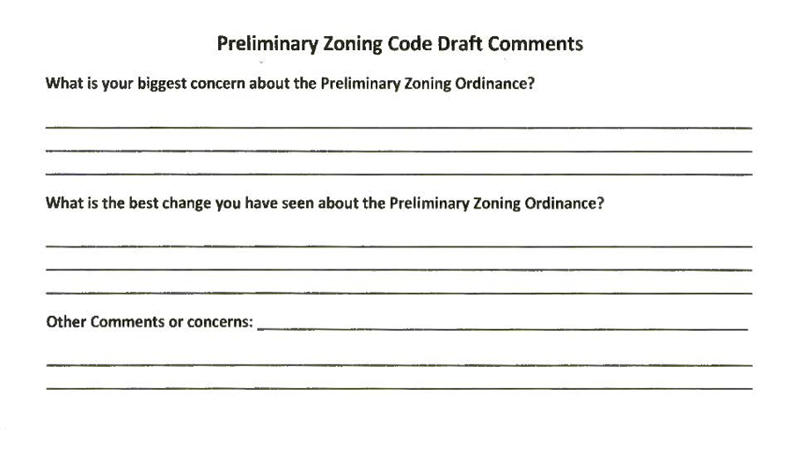
Summary of comment cards from June 13th, 2023, Public Forum
  20 Comment Cards were received on June 13
  Question #1: Biggest Concerns
    Enforcement
    Restrict R1 area
  Question #2: Best Change
    Regulation
    Better Clarification
    Property use is being changed for improvement
  Comments
    In favor of Short-Term Rentals but need enforcement.
    Short-Term Rentals are good for Cadillac. If the tenant is the problem, they can be made to leave or are only there for a short time

Slide 10

Written comments submitted to Staff
Since June 13 Public Forum, 12 letters have been submitted to staff about Short-term Rentals.
  5 letters were reports of STR locations
  7 letters of support for STR’s

Slide 12
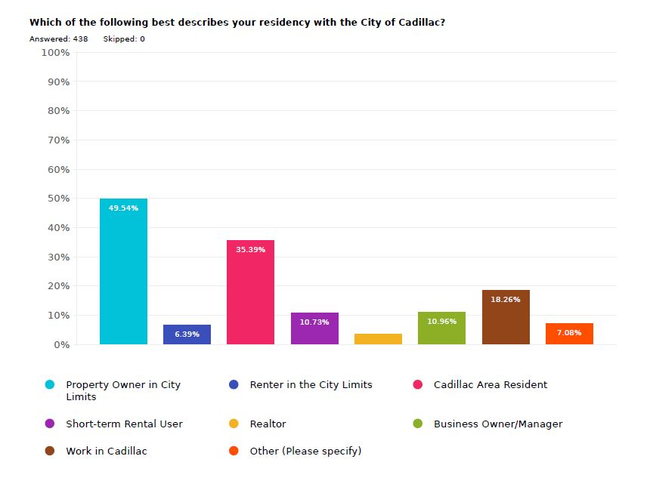
Survey results
Property owner in City Limits
438 Total Responses
“Other”:
  Grew up in Cadillac,
  Investor in Cadillac,
  Parents own property in Cadillac
  Cherry Grove Resident
  Retiree
Cadillac Area
Resident

Slide 13
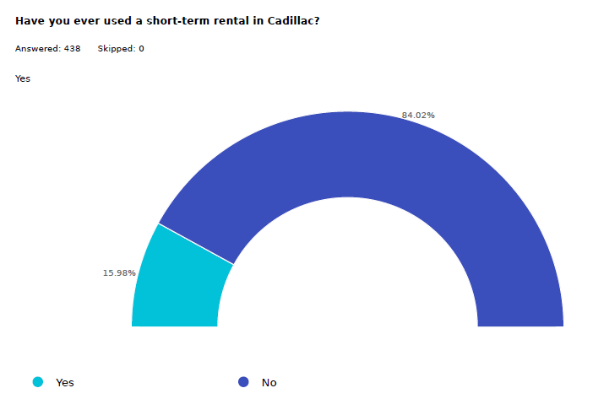
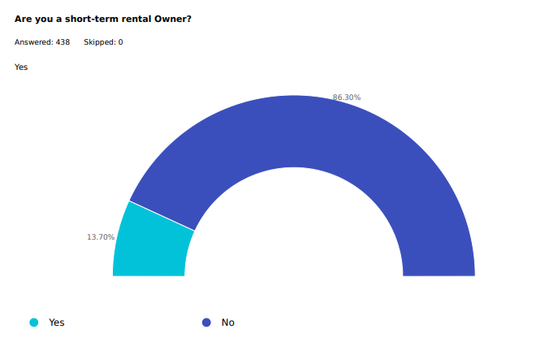
Survey results
Have you ever used a Short-Term Rental in Cadillac?
Are you a Short-Term Rental Owner?
84%
13.7%
84% said No
13.7% said Yes

Slide 14
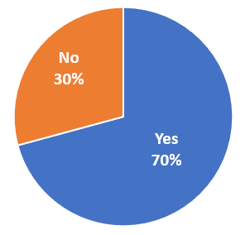
Have you ever used a short-term rental?
70% of people stated they have used a short-term rental and shared the below responses
More personal than using a hotel and accommodating for a family or groups of people.
Positive, convenient and affordable experiences.
Important to be a respectful guest to both homeowners and neighbors.
STR’s allow families to visit together in a home, rather than in hotel rooms. More enjoyable to cook together, hang out and play games.
Guests visit local stores & restaurants thereby boosting the local economy.

Slide 15
Have you ever used a short-term rental?
70% of people stated they have used a short-term rental and shared the below responses
Oftentimes they provide locations and amenities (washer/dryer, kitchen, hot tub, and privacy) that hotels or other options are lacking.
Offers the opportunities to get to know the locals.
Short-term rentals allow our family to travel more and to enjoy more places, as hotels are more expensive, not as clean and not as comfortable.
Short-term rentals are convenient for tourists with children that don’t camp or want to pay for two hotel rooms.
Properties that allow parties or large gatherings have caused problems for us and people we know.

Slide 16
Have you ever used a short-term rental?
30% of people stated they have not used a short-term rental and shared the below responses
Wonderful option but they should have permits & follow certain rules & regs
Great in moderation, I wouldn’t want one next to my home.
STR’s are helpful for tourists but not for working people. They take away houses the locals can live in full time.
Can be a problem for neighbors if loud and disrespectful. STR’s usually have better curb appeal than LTR

Slide 17
Have you ever used a short-term rental?
30% of people stated they have not used a short-term rental and shared the below responses
Not knowing who is in the neighborhood is concerning to me.
Short-term rentals have been around for 100+ years and until recently for the most part something families did with their cottages, and agreements were with a handshake and respect for the other a given.
If monitored correctly they are an important asset for increasing tourist activity in Cadillac.

Slide 18
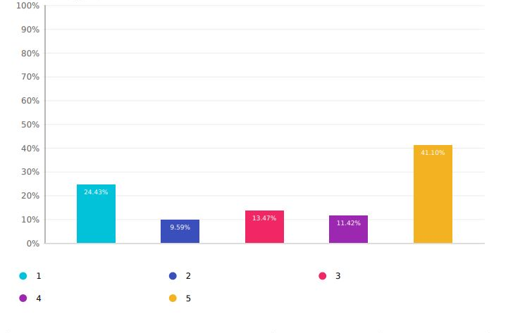
What is your general opinion of STR’s in Cadillac?
Average Rating of 3.35 out of 5
A 67% approval rating.

Slide 19
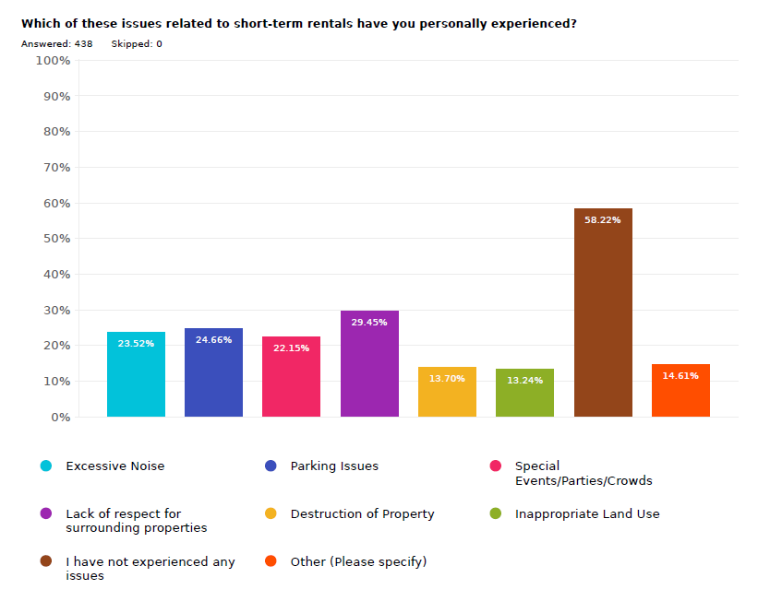
Which of these issues related to str’s have you personally experienced?
“Other” responses
Lack of available permanent housing for residents
Loss of neighborhood feeling
Inappropriate actions from short-term rental users

Slide 20
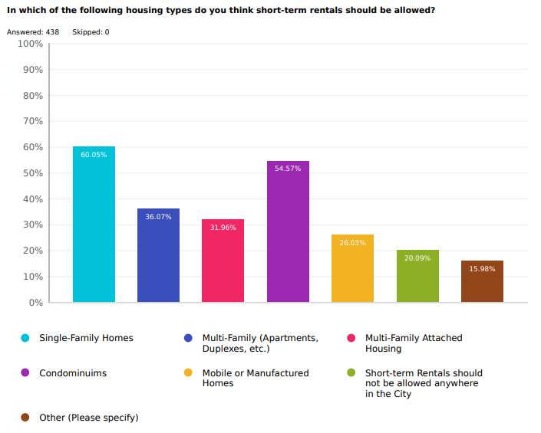
In which of the following housing types do you think str’s should be allowed?
“Other” responses
Properties that are owner occupied
Any housing type but with rules and regulations
Cabins
Cottages along the lake

Slide 21
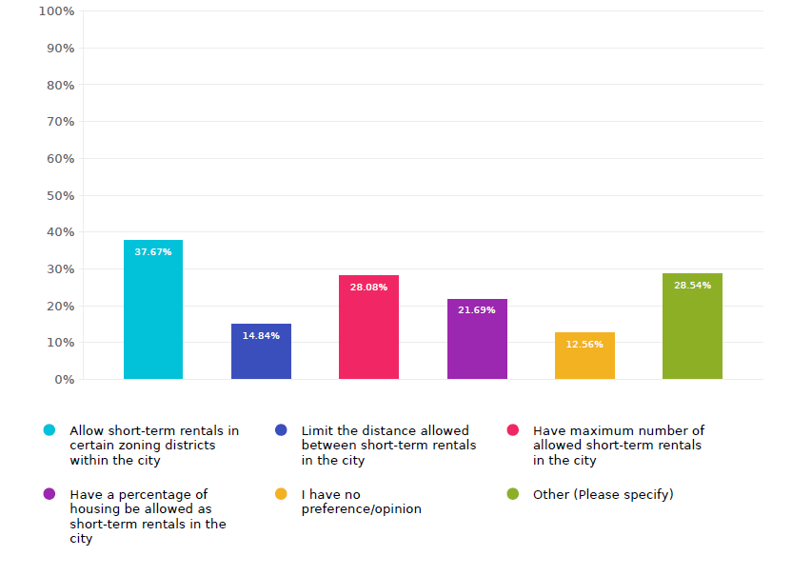
How would you like to see the city handle str’s?
“Other” responses
No Restrictions
Regulate number of occupants and prohibit events/parties
Allow STRs with a permit to help ensure responsible ownership and use
Prohibit STRs

Slide 22
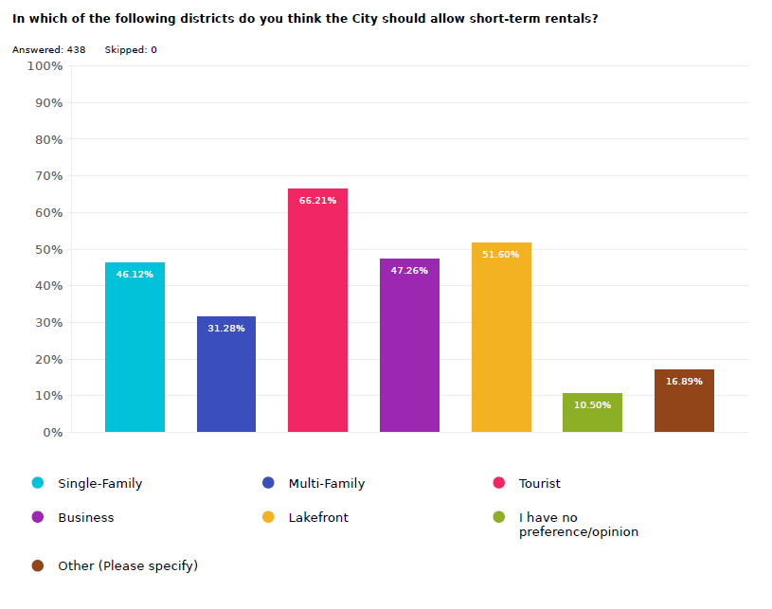
In Which of these districts do you think str’s should be allowed?
“Other” responses
City should not restrict any property owner from using their property as a STR as long they are running a safe rental.
None
District doesn’t matter as long as they are subject to restrictions
Should be allowed in all districts

Slide 23
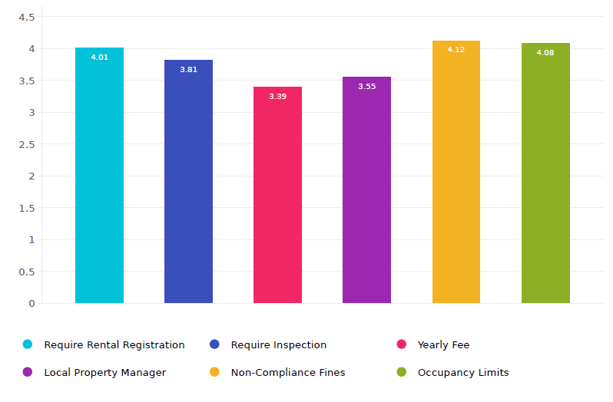
How important are the following regulations?

Slide 24
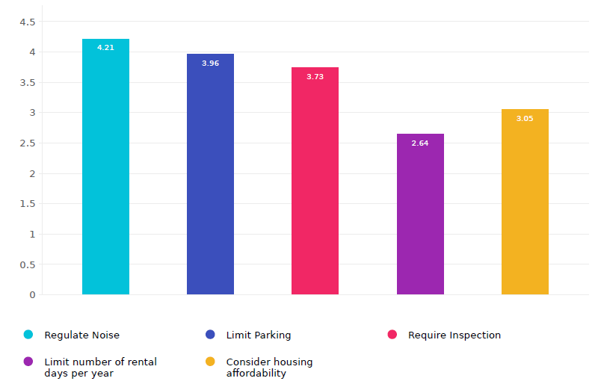
How important would it be to regulate the following concerns?
TEXT

Slide 25
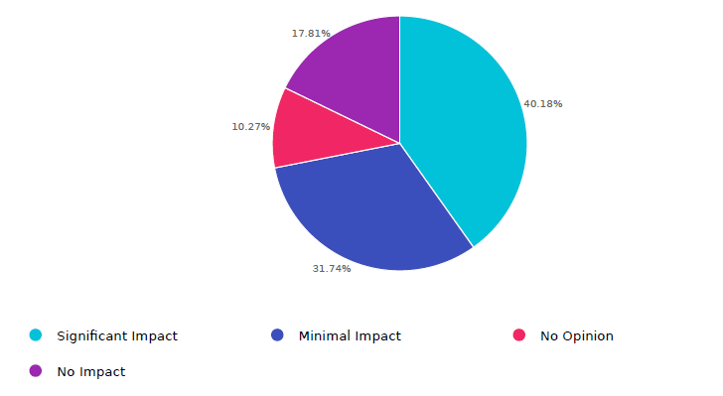
Short-term rental impact on long-term rental housing
49.56% believe it minimal to no impact.
40.18% believe it has significant impact.
10.27 % had no opinion.

Slide 26
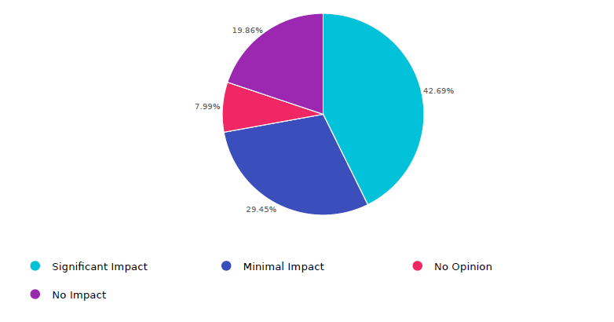
Short-term rental impact on single family homeownership in Cadillac
49.31 % believe there is minimal to no impact
42.69 believe there is significant impact
7.99 % had no opinion

Slide 27
Views on housing and short-term rentals in the community
50% of people agreed that short-term rentals provide a positive benefit to permanent city residents
86% of people agreed that short-term rentals provide benefit to their owners & investors
70% of people agreed that short-term rentals provide a positive benefit to local businesses
46% of people agreed that increases in short-term rentals have made affordable housing hard to find
84% of people agreed that short-term rentals provide the homeowner with additional income.

Slide 28
Short Answer responses received in survey
Many responses related to enforcement:
  Require up to date photos on the website advertising the rental. No fake photos.
  Need for an enforcement plan.
  Hiring constables whose sole duty is the policing of short-term rentals.
  More frequent inspections than in the already established rental program.
  Should be an easy place to report complaints.

Slide 29
Short Answer responses received in survey
Fees should be charged for short-term rentals
  Sales tax
  Tourism assessment
  Enforcement
  Business license
  Limit the number of short-term rentals that can be owned by one entity
    Do not allow corporations to buy up houses for this purpose
    Redefine short-term rentals as those which are rented for less than 30 days
    Recognize different situations of short-term rentals and regulate accordingly
      Owner occupied rentals
      Medical professionals
      People who are renting for short periods of time per year such as 14 days
      Spatial distance between STR’s
      Limit how many short-term rentals on the lake
      Establishment of house and property maintenance rules

Slide 30
Short Answer responses received in survey
Many people looking into a lakefront home cannot be here year-round and are interested in offsetting the costs of the home through short-term rental.
Short-term rentals can be more affordable than staying in hotels and have more benefits.
There is concern about STR’s driving up housing prices, limiting year-round rentals, and over commercializing the City.
Several people feel that STR’s are better maintained than year-round rentals and will have a positive effect on the economy, tourism, and business.
Opposing views were reported on if STR’s belong in single-family areas, several for and against.
Many responses shared concerns about STR’s limiting property owner’s rights.

Slide 31
Updates Based on Feedback Received
STR Draft Ordinance Updates
Planned Enforcement
Map Options

Slide 32
STR Draft Ordinance Updates
Clarification that Short-Term Rentals are 30 days or less. Anything longer is considered Long-Term Rental
Parking requirements defined. Any extra requested parking must be approved by Planning Commission
Violation Limits for Revocation of licenses
“Good Neighbor Guidelines” added to ensure tenants are aware of local rules. Property owners must detail how they plan to enforce the “Good Neighbor Guidelines”
Staff given powers to revoke Short-Term Rental Certificates
  Certain violations are automatic revocation

Slide 33
Current enforcement efforts underway
LEGAL UPDATE

Slide 34
PLANNED Enforcement
The updated Draft STR Ordinance includes more enforcement:
  Violation limits
  Planning Commission Approvals
  Special Land Use requirements
  Fines and Fees yet to be determined

Slide 35
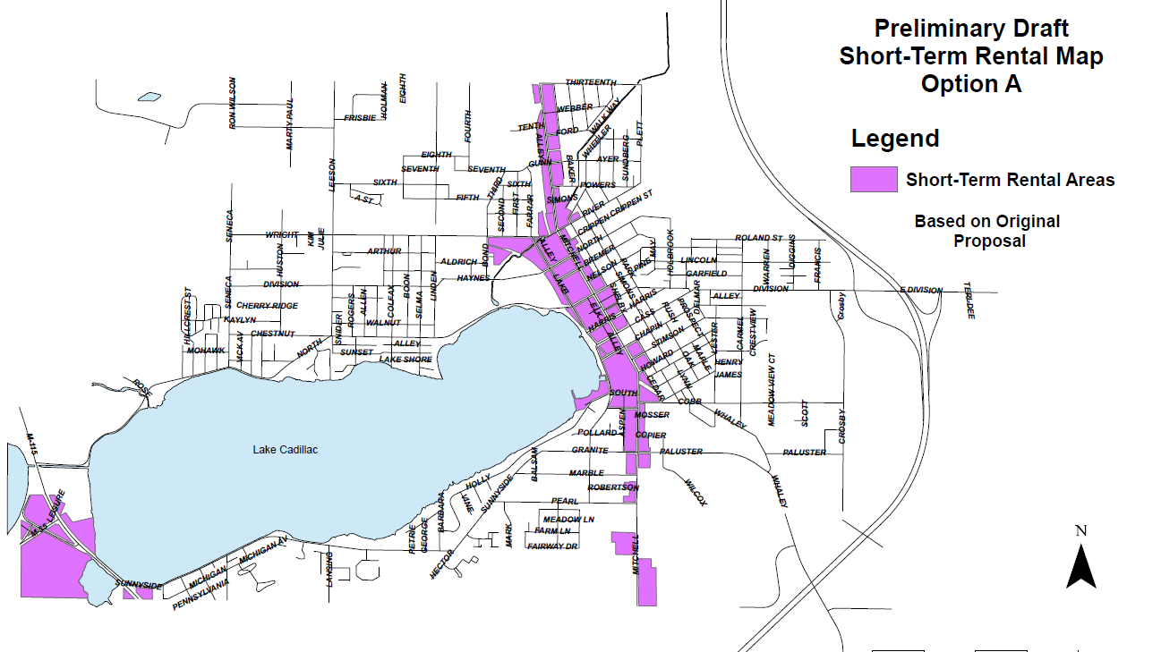

Slide 36
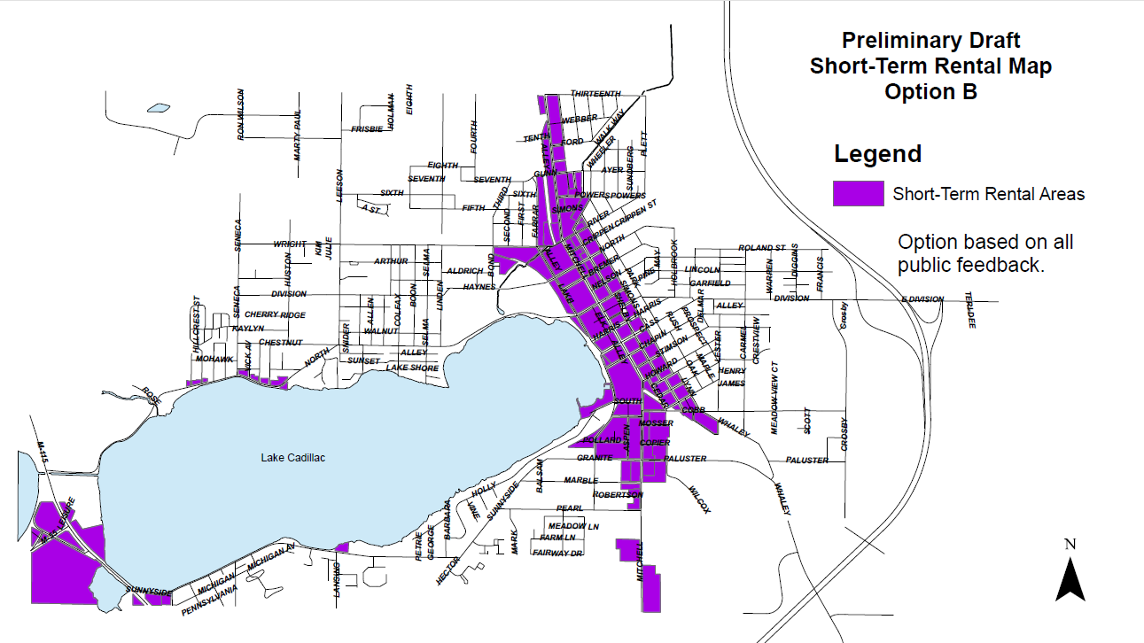

Slide 37

enjoy a refreshment and turn in your comment cards

Slide 38

Question and answer

Slide 39
Next steps
Planning Commission
City Council
ZONING ADOPTED
PUBLIC HEARING REVIEW
REVIEW ENTIRE ORDINANCE
ADOTION OF ENTIRE ZONING ORDINANCE
Planning commission
CITY COUNCIL
RECOMMENDATION TO COUNCIL
PUBLIC HEARING

Slide 40
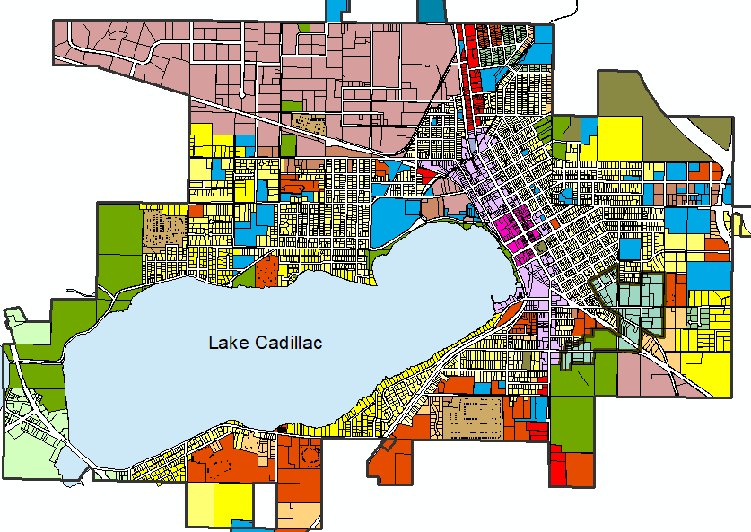
Thank you!
John Wallace​
Community Development Director
jwallace@cadillac-mi.net
231-779-7325

