Slide 1
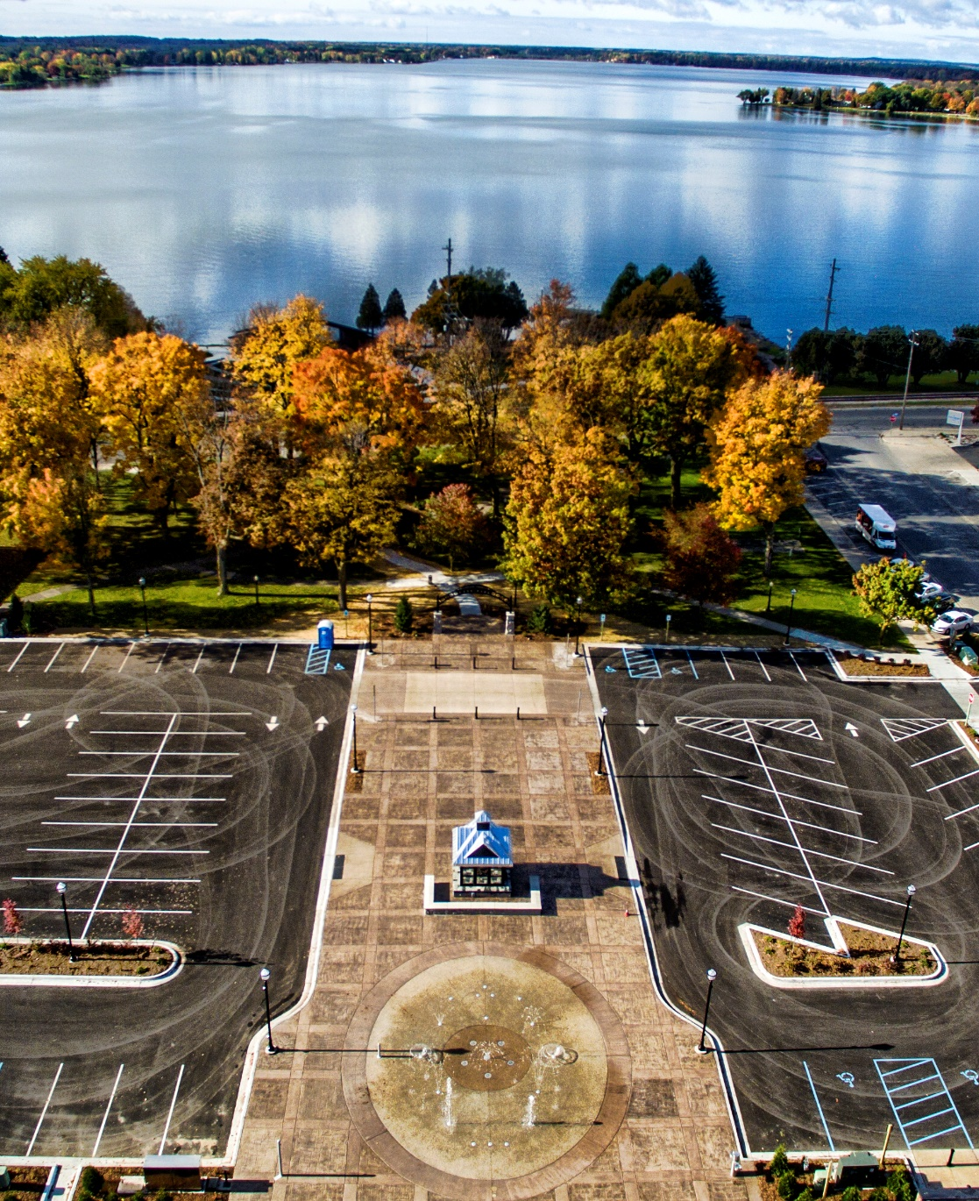
City of Cadillac New zoning ordinance
John Wallace
Community Development Director

Slide 2
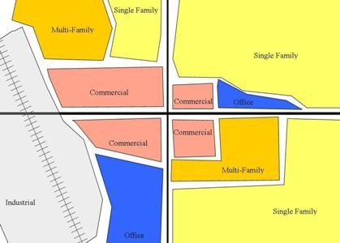
Introduction
The updated zoning ordinance represents a document that is consistent with current zoning law, current themes in development types and patterns, and is consistent with zoning themes being promoted by the State of Michigan Redevelopment Ready Communities program. This updated zoning ordinance has been designed to streamline both the development approval process and the administration of the ordinance.

Slide 3
Major Themes for the zoning rewrite
Increase clarity and ease of Use
Streamline in-house zoning administration
Streamline the Development process
Meet redevelopment Ready Program Goals
Make consistent with current zoning laws and zoning practice

Slide 4

Make consistent with current zoning laws and zoning practice
Update the sign portion of the ordinance to make sure it is content neutral.
Remove tiered zoning districts.
Update the definitions section and insert new terms that are in practice.
Update the ordinance regarding new state mandated zoning provisions.

Slide 5
Make consistent with current zoning laws and zoning practice
Switch from classifying commercial zones based on intensity to more functional classification system. Going from B-1, B-2, and B-3 to Downtown, Downtown Core, and General Commercial.
Review residential district development patterns for consistency with trends and need and allow increased opportunities for accessory dwelling units.
Creation of a commercial overlay district to recognize the pre-existence of sites historically used for business purposes in non-commercial areas. Example: pizza shop by the high school. Intended to improve walkability and reduce auto usage.

Slide 6
Make consistent with current zoning laws and zoning practice
Creation of a multi-purpose revitalization overlay district. Provide opportunity for limited-low-impact business development and duplex creation in the transitional areas immediately contiguous to the downtown. This should allow more opportunity for business startups and increase housing availability.
Creation of an updated residential planned unit development district intended to improve project designs and reduce infrastructure and housing costs.
Creation of a medical-office park district to recognize the Munson Hospital Campus area along with adjacent professional offices.
Airport district. Recognize the specific character/use of the Wexford County Airport site.

Slide 7

Increase Clarity and Ease of Use
Increase clarity and ease of use
Include all permitted uses both “by right” and by special land use within each zoning district of the zoning ordinance. Eliminate the tiered system of zoning.
Revise the definition section of the ordinance.
Add illustrative graphics.
The zoning ordinance will be formatted to work with the Municode online platform.
Reduce multiple-family districts from two districts to one.
Reduce industrial districts from two districts to one.
Update the sign portion of the ordinance to make sure it is content neutral.

Slide 8

Streamline the Development process
Increase Clarity and Ease of Use
Increase clarity and ease of use
Continue to have site plan review conducted by department heads rather than the planning commission. Saves time by not having to wait for monthly meetings.
Authorize the zoning administrator to approve minor changes to approved site plans.
Authorize the zoning administrator to approve the exclusion of site plan information determined unnecessary.
Provide opportunity for commercial parking lots to reduce parking spaces based on a demonstration of need. General reduction in minimum parking requirements.
Simplify sign standards and modify to reflect need.
Update the sign portion of the ordinance to make sure it is content neutral.

Slide 9
Streamline the Development process
Increase Clarity and Ease of Use
Increase clarity and ease of use
How does the ordinance facilitate new housing?
The city will continue its practice of no minimum housing size.
This ordinance will allow for accessory dwelling units both internal and external units.
The parking requirements for multiple-family developments are being lowered.
The city is creating a new attached housing district.
The city is providing for increased opportunities for the conversion of single-family homes to two-family homes near the downtown.
The residential planned unit development has been rewritten to allow for increased density in housing projects and improved design features.
Update the sign portion of the ordinance to make sure it is content neutral.

Slide 10

Streamline in-house zoning administration
Streamline the Development process
Increase Clarity and Ease of Use
Increase clarity and ease of use
Reduce the number of uses requiring a special land use permit.
Reduction in vague terms or regulations within the zoning ordinance
Increased ability for the zoning administrator to approve minor changes to site plan.
A simplification of the sign section of the ordinance.
Specific regulations pertaining to short-term rentals.
Permitted land uses by district contained within the district section.
Update the sign portion of the ordinance to make sure it is content neutral.

Slide 11


Meet redevelopment Ready Program Goals
Meet Redevelopment Ready
Program goals
Increase Clarity and Ease of Use
Mixed-use projects “by right” in the downtown districts.
Introduction of shared parking arrangements.
Requirement for bicycle parking and auto parking credits for bicycle parking.
Requirement for public sidewalks and connection to private sidewalks on-site.
Streamlined review processes. Commercial and industrial site plans are reviewed by department heads typically within a two-week process and don’t require planning commission approval.
Update the sign portion of the ordinance to make sure it is content neutral.

Slide 12

How will Ordinance help Housing?
The City will continue to not mandate a minimum housing size.
Internal and external accessory dwelling units may be permitted in the ordinance.
The city has increased the amount of property zoned for multiple-family development
A single-family and attached housing district is being introduced.
Parking requirements for multiple-family housing developments are being lowered which should result in lower lease costs.

Slide 13
Timeline
Fall/Winter 2023
Summer 2023
Fall 2023
Final Ordinance Formatting and Ordinance goes into effect.
Public outreach on the Zoning Ordinance
Review by Planning Commission
Summer/Fall 2023
Fall 2023
Legal Review
Review by City Council

Slide 14
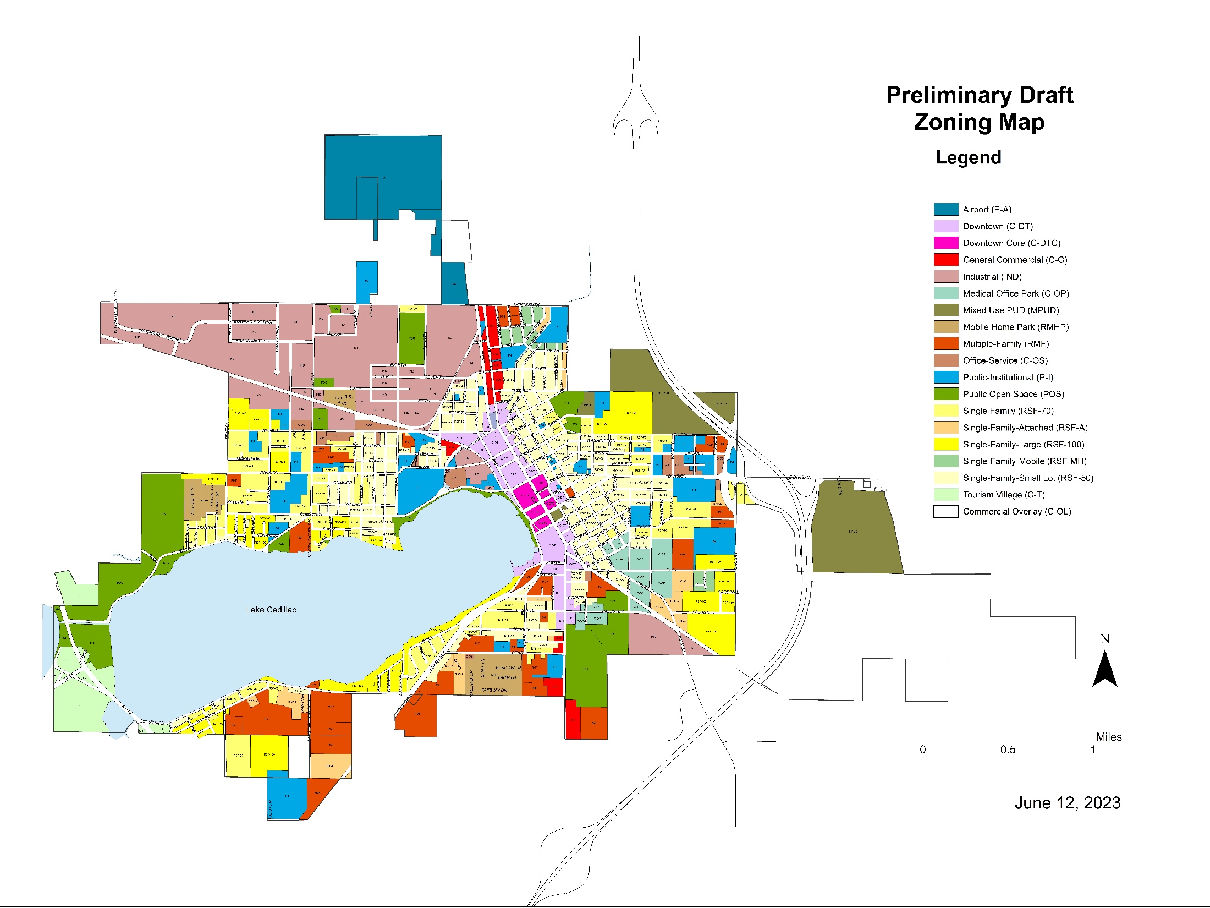

Slide 15
Short-Term rentals
Why consider short-term rentals?
Use has become common over the past several years throughout the state and country
The city has experienced tourists desiring the use of short-term rentals.
The state has commonly overridden local zoning when there has been a demonstrated need or demand for uses that many might prefer to prohibit or restrict. Examples:
- Biofuel production facility
- Wireless communications equipment
- Home occupation to give instruction in a craft or fine art within the residence
- The extraction of certain natural resources
- Certain signs on or within buildings and the content of signs
- State licensed residential facilities such as childcare and foster care facilities
- Various residential (healthcare) treatment programs

Slide 16
If approved where might short-term rentals be allowed?
C-T – Tourism Village (Former TS-1/TS-2)
C-DT – Downtown Commercial
C-DTC - Downtown Core Commercial
C-G – General Commercial
These districts provide for a mix of residential, office, and commercial uses. The TS-1 and TS-2 Tourist Service Districts (proposed for combining as the C-T Tourism Village District) have historically been designed to accommodate activities necessary to service tourist needs including retail, a range of accommodations, parks, recreation, and public uses.

Slide 17
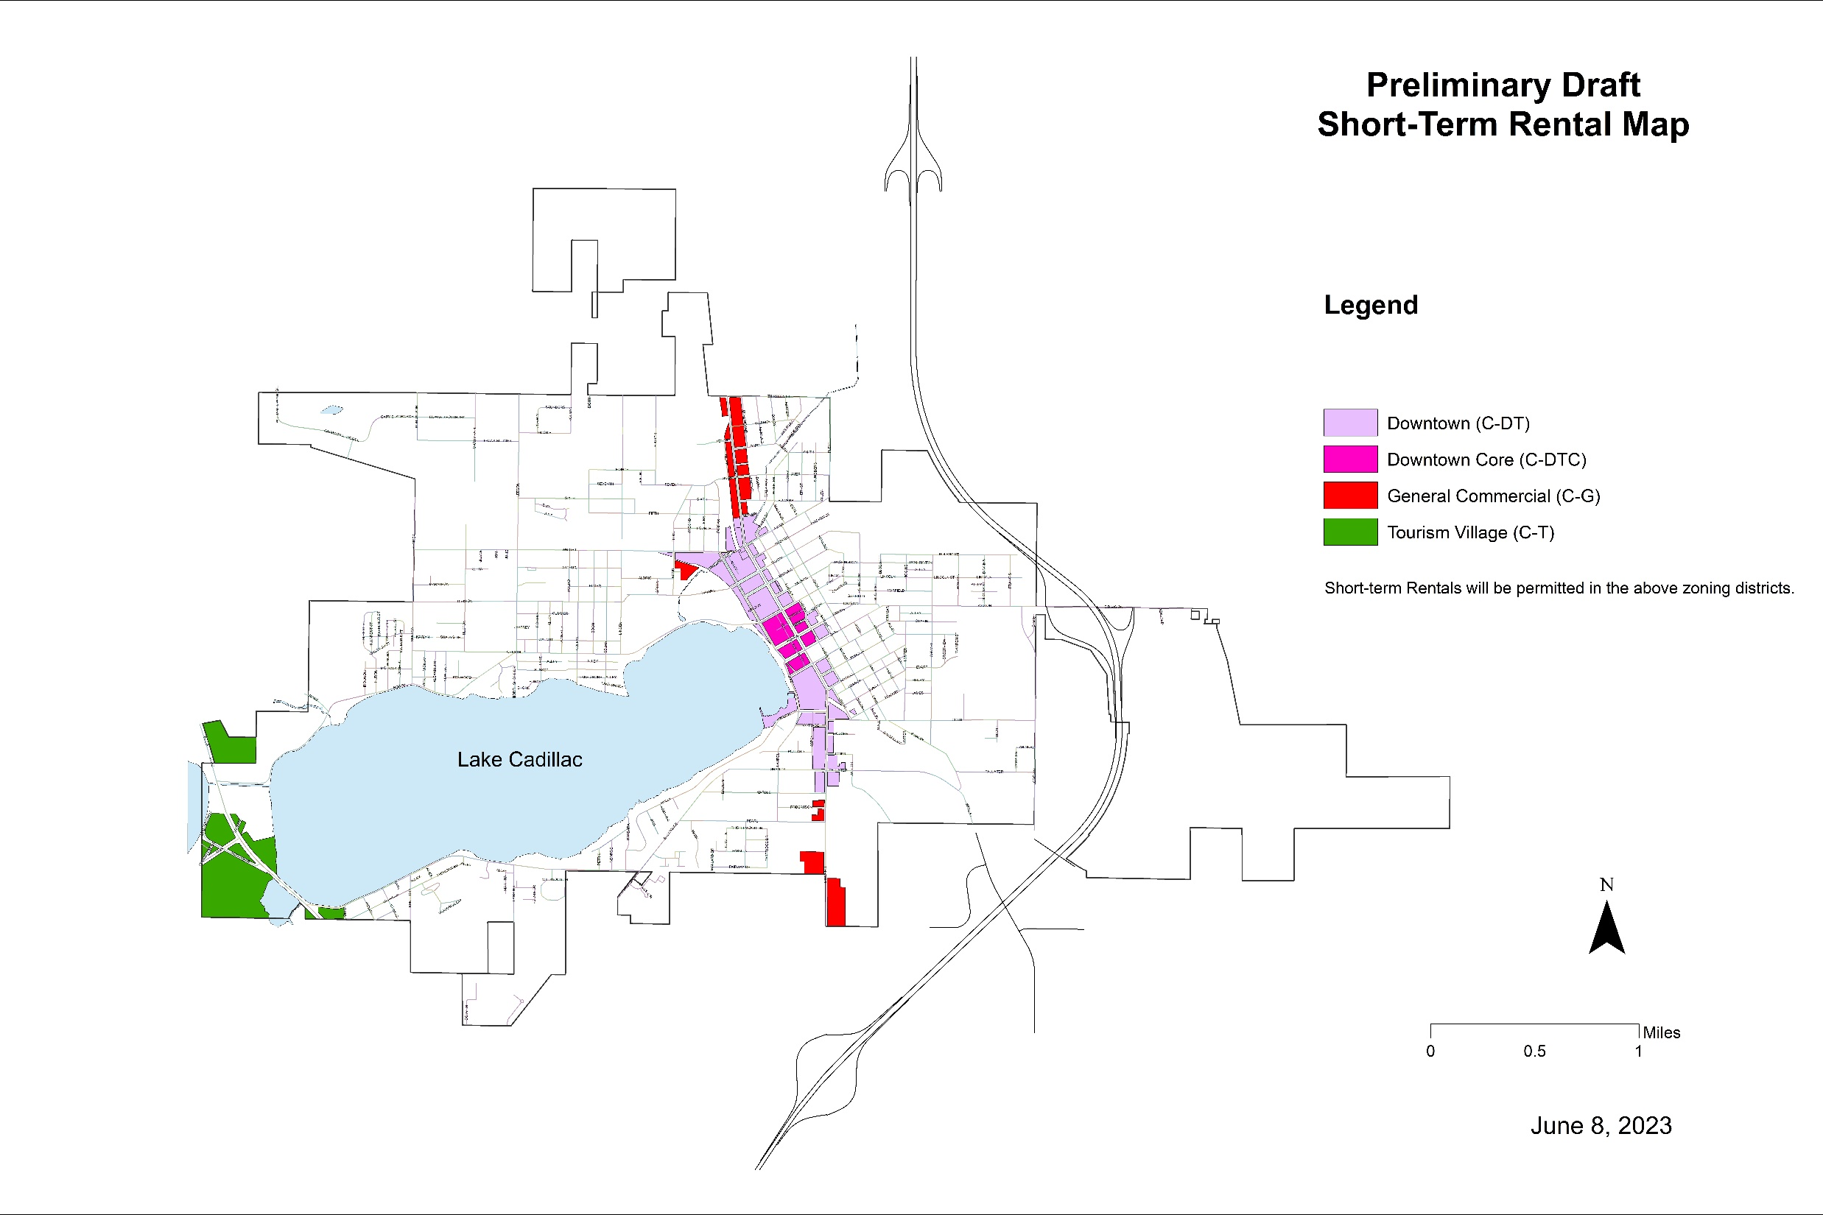

Slide 18
Basis of the draft standards for short-term rentals
1. Examined other communities (locally and nationally). Will mention some.
2. Examined Article IV, Section 8 of the Cadillac City Code governing long-term rentals for possible application.
Compared to the average ordinance, we took a more comprehensive, restrictive, approach. Examples:
a) Mandatory inspection periods
b) Ownership/management response requirements
c) Prohibition of special events/gatherings by non-registered occupants
d) Prohibit lawn parking
e) Limit on bedroom occupancy
f) Revocation standards
g) Limited to mixed-use and tourism districts.

Slide 19
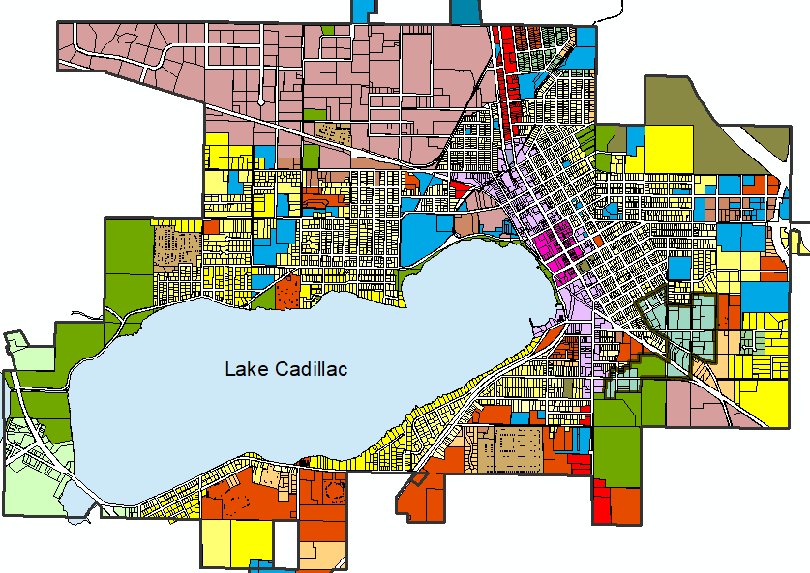
Thank you!
John Wallace​
Community Development Director
jwallace@cadillac-mi.net
231-779-7325

